Slide 1
Hospital & patient management system
Submitted by
Abhishek dakhore
Internship id : UMIP280569

Slide 2
Introduction & Project Overview
The Hospital Management System is developed to automate and simplify the hospital workflow. Traditionally, hospitals maintain large amounts of paperwork to store patient records, doctor information, billing data, and checkup reports. This system aims to digitize all those processes by offering an online web-based platform that can be accessed by hospital staff such as doctors, receptionists, and administrators.
At the heart of this project lies the Arogya Setu Card, a digitally generated health ID card that contains a unique QR code and personal details of the patient. When a patient is registered, either by a doctor or receptionist, they receive this card. The QR code links directly to the patient’s complete medical history stored in the database, such as medications, surgeries, allergies, injuries, past checkups, and reports.

Slide 3
System Design & Modules
The Home Page is designed with simplicity and functionality in mind. It features a navigation bar with clear options for different users:
Admin Login
Doctor Login
Receptionist Login
Suggestion/Complaint Box
About Us
Download Arogya Setu Card
View Hospital Info and Patient Status

Slide 4
Admin Module: The admin controls user accounts and has the highest access level. Admins can monitor complaints, view system-wide activity, manage data backups, and control room availability.
Doctor Module: Doctors log in to see their assigned patients, view or update patient medical history, and enter new checkup details. They can also prescribe medicine and view previous treatments.
Receptionist Module: Receptionists handle patient registration, generate Arogya Setu cards, assign rooms, create bills, and manage feedback from the suggestion/complaint box.
The system also includes a complaint management module. Anyone can submit a complaint through the homepage without logging in. These complaints are visible only to receptionists, who can delete them after resolution.
The About Us page and Hospital Info section provide visitors with details about the hospital’s services, address, and contact number. Patients can also download their Arogya Setu card if they lose it.

Slide 5
Patient Handling System
The system starts with Patient Registration. A patient can be registered by a receptionist or a doctor. During registration, all necessary data is collected — name, age, gender, address, contact, symptoms, previous conditions (if known), etc.
Once registered, the system automatically generates the Arogya Setu Card, a health ID card containing a QR code, patient ID, and personal details. This card serves as a permanent digital identity for the patient in the hospital system.
The QR code is generated using a backend script and encoded with the patient's unique ID. Scanning this QR with a mobile or desktop scanner takes the doctor or receptionist directly to the patient’s full medical record.
The database design is key. Tables include patients, doctors, receptionists, complaints, bills, rooms, checkups, medicines, and arogya_cards. Each table is linked via foreign keys to ensure relational integrity.

Slide 6
System Features & Technology Stack
The system is built using a web technology stack for maximum compatibility:
Frontend: HTML5, CSS3, JavaScript (for UI and validation)
Backend: PHP (for server-side logic)
Database: MySQL (for storing patient data securely)
Extras: QR Code library, JavaScript alert and logging libraries
The Doctor Dashboard allows doctors to:
Search for patients using ID or QR
View and edit checkup records
Add diagnosis or medicines
Access history of previous treatments
Print patient summaries

Slide 7
he Receptionist Dashboard includes:
New patient registration
Room allocation
Discharging patients
Complaint monitoring and deletion
Billing and payment status
Billing Module calculates hospital charges based on room type, medicines issued, lab tests, and other services. Once a patient is discharged, the system generates a bill and clears the room.

Slide 8
Room Allocation is dynamic. The system checks available rooms and assigns them based on availability and patient type (e.g., general ward or private room).
Security Measures include:
Encrypted passwords for all users
Role-based access control (admin > doctor > receptionist)
Session timeout and logout features
QR code secured with hash-based redirection
The entire system is designed to be portable and scalable, allowing future expansion to include lab modules, ambulance services, and mobile apps.

Slide 9
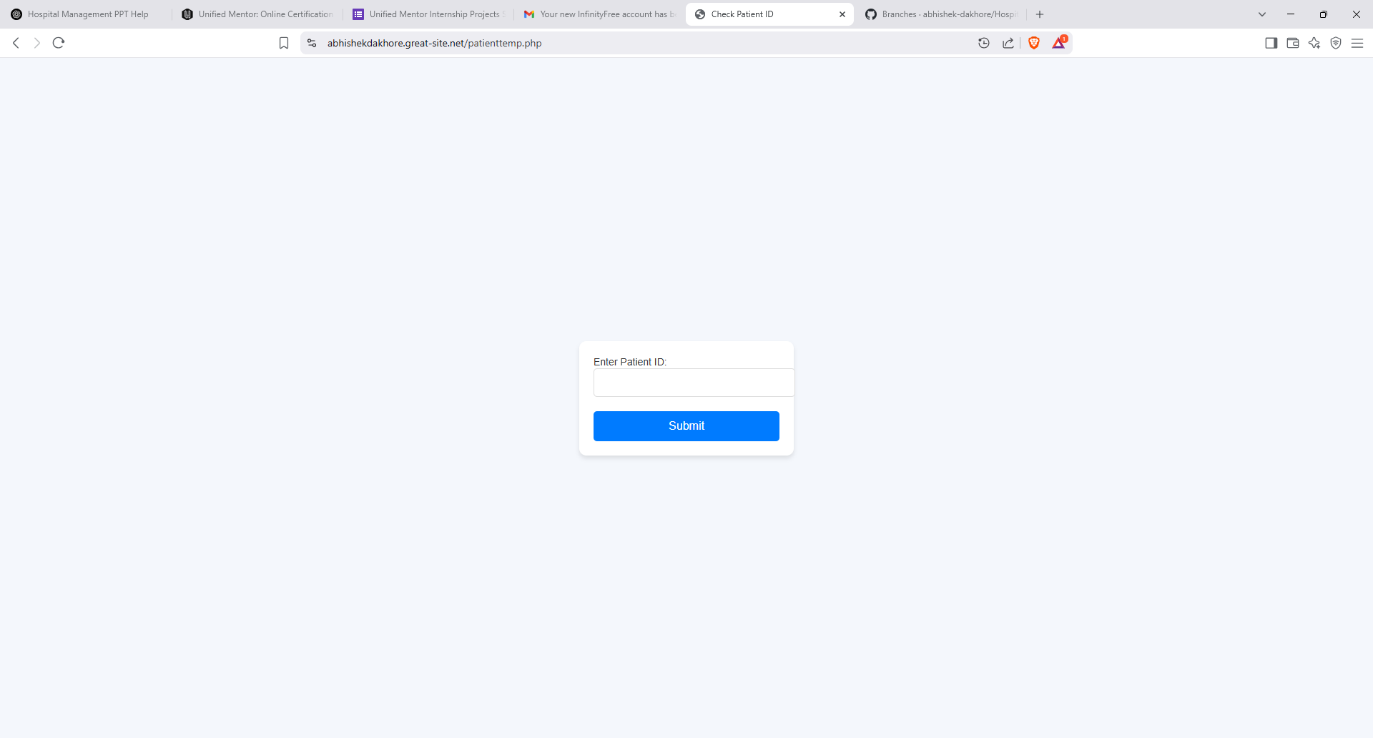
Screenshots

Slide 10
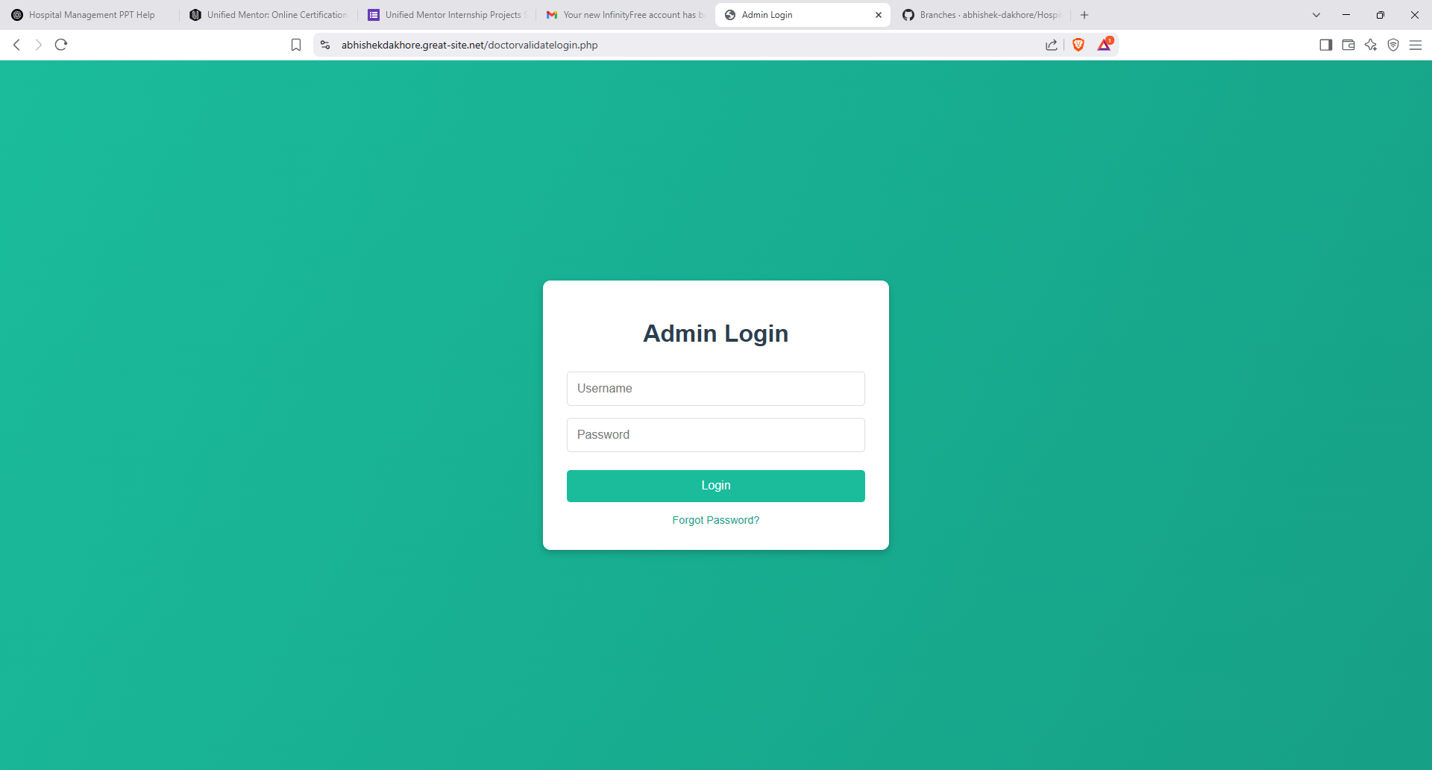
SCREENSHOT

Slide 11
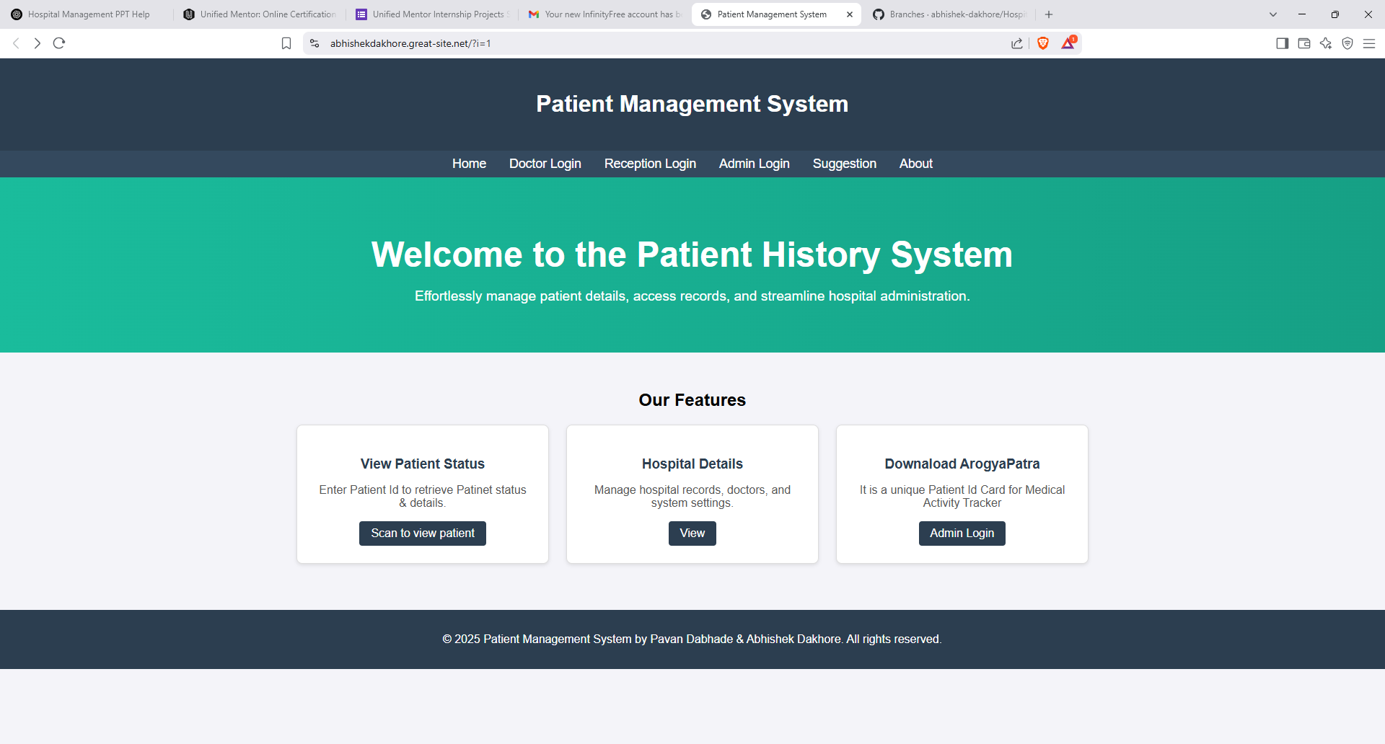
SCREENSHOT

Slide 12
Challenges Faced
eveloping the Hospital Management System came with several technical and practical challenges that needed to be overcome to ensure the system works efficiently. Some of the primary challenges faced during the development process included:
Database Schema Design: Creating a scalable and normalized database schema for storing patient information, medical history, doctor data, room allocation, and billing details was one of the first hurdles. Ensuring that data integrity is maintained without redundant data required careful planning of relationships between tables.
QR Code Generation and Integration: The Arogya Setu Card required generating unique QR codes for every patient. Integrating the QR code generation functionality and ensuring that the QR code links securely to the right patient’s medical history was a tricky challenge. Any mislinking could lead to incorrect patient information being displayed.

Slide 13
Testing
esting was an essential part of ensuring the system’s stability and reliability. The following types of tests were performed:
Unit Testing: Each module (patient registration, billing, room allocation) was tested individually to ensure they functioned correctly. The database operations, form validations, and QR code generation were also tested to make sure they met the specified requirements.
Integration Testing: Once individual modules were working, the integration between various components (like how patient records are connected to doctor visits, complaints, and billing) was thoroughly tested. Any issues with how the modules interacted were resolved at this stage.

Slide 14
Performance Testing: The system was tested for performance under varying loads. Tests were conducted to check how the system performs with multiple users accessing it simultaneously. This helped identify bottlenecks and optimize the system for better performance.
Security Testing: Since the system stores sensitive data, comprehensive security testing was conducted to prevent data breaches. This included testing for SQL injection vulnerabilities, checking encryption techniques for data storage, and ensuring secure login mechanisms were in place.

Slide 15
Deployment
Once the system passed all testing phases, the deployment process was carefully planned. Deployment involves moving the developed system from a local development environment to a live server, where it can be accessed by users. The deployment process for this system included:
Server Setup: The system was deployed on a Infinityfree(a free platform) for scalability and reliability. PHP was configured to host the application, while MySQL was used to manage the database.
Database Migration: All the patient, doctor, and hospital data from the development database was migrated to the live database. This ensured that no data was lost during the transition and that the live system reflected accurate information.

Slide 16
Future Scope
The Hospital Management System has a great deal of potential for future enhancements and extensions. Some areas for future scope include:
Mobile App Development: A mobile version of the system would enable both patients and healthcare professionals to access the platform on the go. Patients could book appointments, check medical history, and view reports from their phones.
Integration with National Health Databases: The system could be integrated with national health systems or government databases to share patient information securely across different healthcare providers, improving the continuity of care for patients.

Slide 17
TelemedicineIntegration: As telemedicine becomes more popular, integrating video conferencing or remote consultations could be part of the system. This would allow doctors to consult patients remotely, especially in rural or underserved areas.
AI-PoweredDiagnostics: Implementing machine learning algorithms could help doctors in diagnosing conditions based on patient history, lab reports, and symptoms, providing recommendations for treatment or diagnosis.

Slide 18
Maintenance
After deployment, the system requires regular maintenance to ensure its continued functionality. Some of the key aspects of maintenance include:
Bug Fixes: Any issues reported by users or identified during operation would be addressed promptly. These could be issues like broken links, data entry errors, or missing functionalities.
System Updates: The software, security patches, and dependencies (e.g., PHP, MySQL) must be updated regularly to keep the system secure and up to date with the latest features.

Slide 19
Database Optimization: Over time, the database may grow, leading to slower query responses. Database optimization, including indexing and query optimization, would help ensure that the system remains fast and responsive.
User Support: Providing ongoing technical support to hospital staff and administrators will ensure that the system is being used properly and that any questions or issues are addressed quickly.
Scalability: As the hospital grows, the system must be scalable to handle increased data and users. Regular evaluations would ensure that the infrastructure can scale as needed, whether it's adding more storage or improving performance.

Slide 20
Conclusion
The Hospital Management System project has successfully automated the core processes of hospital management, replacing traditional manual systems with an efficient, secure, and accessible digital platform. This system has significantly reduced paperwork, improved treatment accuracy, and optimized hospital workflows by providing quick access to medical records, complaints, and billing information.
With its features like the Arogya Setu Card, QR code integration, and role-based access control, the system is designed to cater to the needs of healthcare professionals and patients alike. By providing a secure and easy-to-use platform, it not only enhances the hospital’s operational efficiency but also improves patient satisfaction and care.

Slide 21
links
Live Website link
https://abhishekdakhore.great-site.net/?i=1#home
Github
https://github.com/abhishek-dakhore/Hospital-Mangaement-System

Slide 22
Thank You..!

